Slide 1
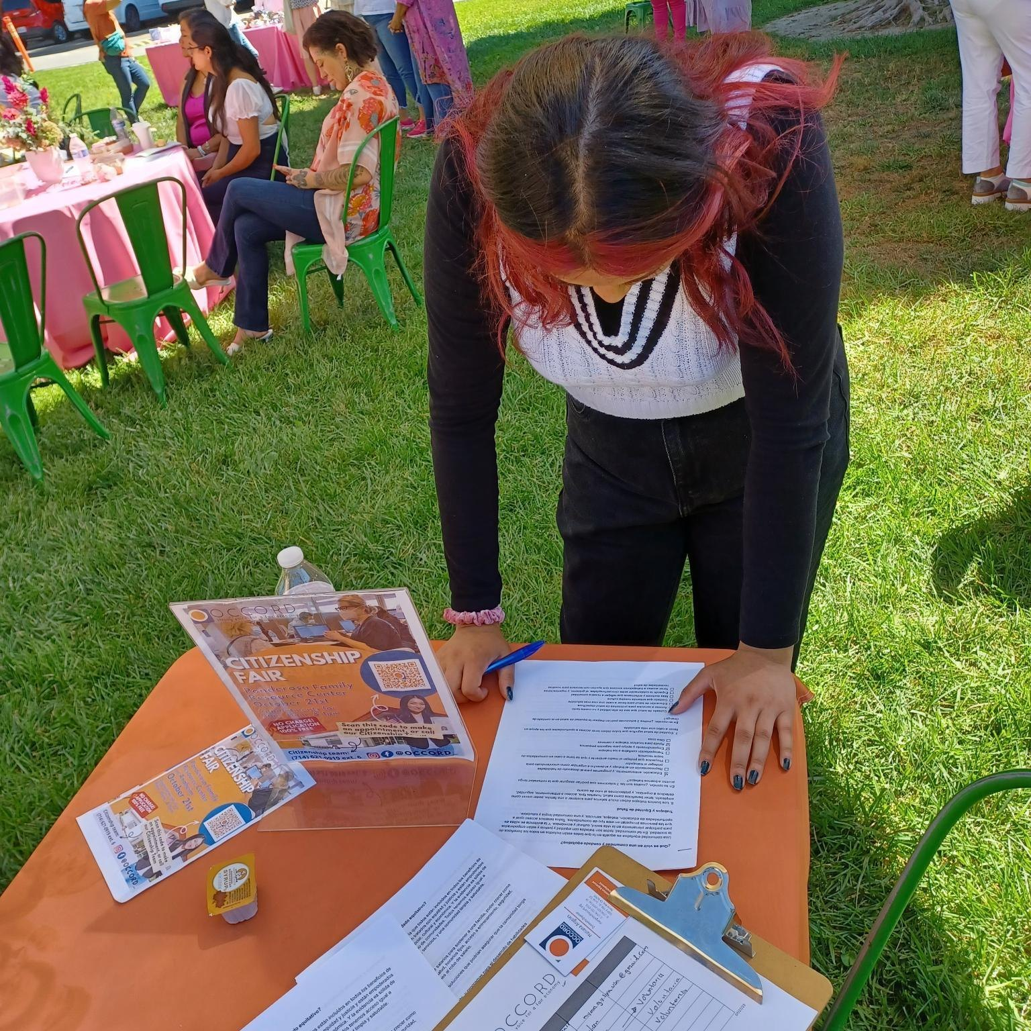
CERF Orange County How We Facilitated Outreach & Engagement
October 27, 2023
OCCORD

Slide 2
Purpose of O&E
To seek feedback from residents, businesses, and other stakeholders, with a focus on disinvested community members in Orange County
Accessing high-quality jobs
Health equity
Environmental equity
Economic equity
Challenges to attaining equity
Building a High Road economy in our region
Potential strategies and solutions

Slide 3
Timeline
April 26
RFP released
May 26
Proposals due
June 12
Decisions made
27 grantees
June/July
Strategy convening
July/Aug/Sept
O&E conducted
Sept 30
O&E wraps
Training

Slide 4
About outreach
Languages
Arabic
Chinese
Dari
English
Farsi
Gujarati
Hindi
Korean
Spanish
Tagalog
Vietnamese
Locations
Anaheim
Santa Ana
Westminster
Garden Grove
Fountain Valley
Orange
Huntington Beach
Fullerton
Costa Mesa
Irvine
Newport Beach
Tustin
Buena Park
Stanton
Lake Forest
Midway City
Seal Beach
San Juan Capistrano
Mission Viejo
Aliso Viejo
Placentia
Brea
And certain unincorporated areas of the county

Slide 5
Outreach mechanisms
Radio shows
Surveys
Social media
Community forums
Canvassing
Festivals
Food distribution events
Town halls
Blogging
Mixers
Pop-up events
Conferences
Traditional ethnic media
One-on-one interviews

Slide 6
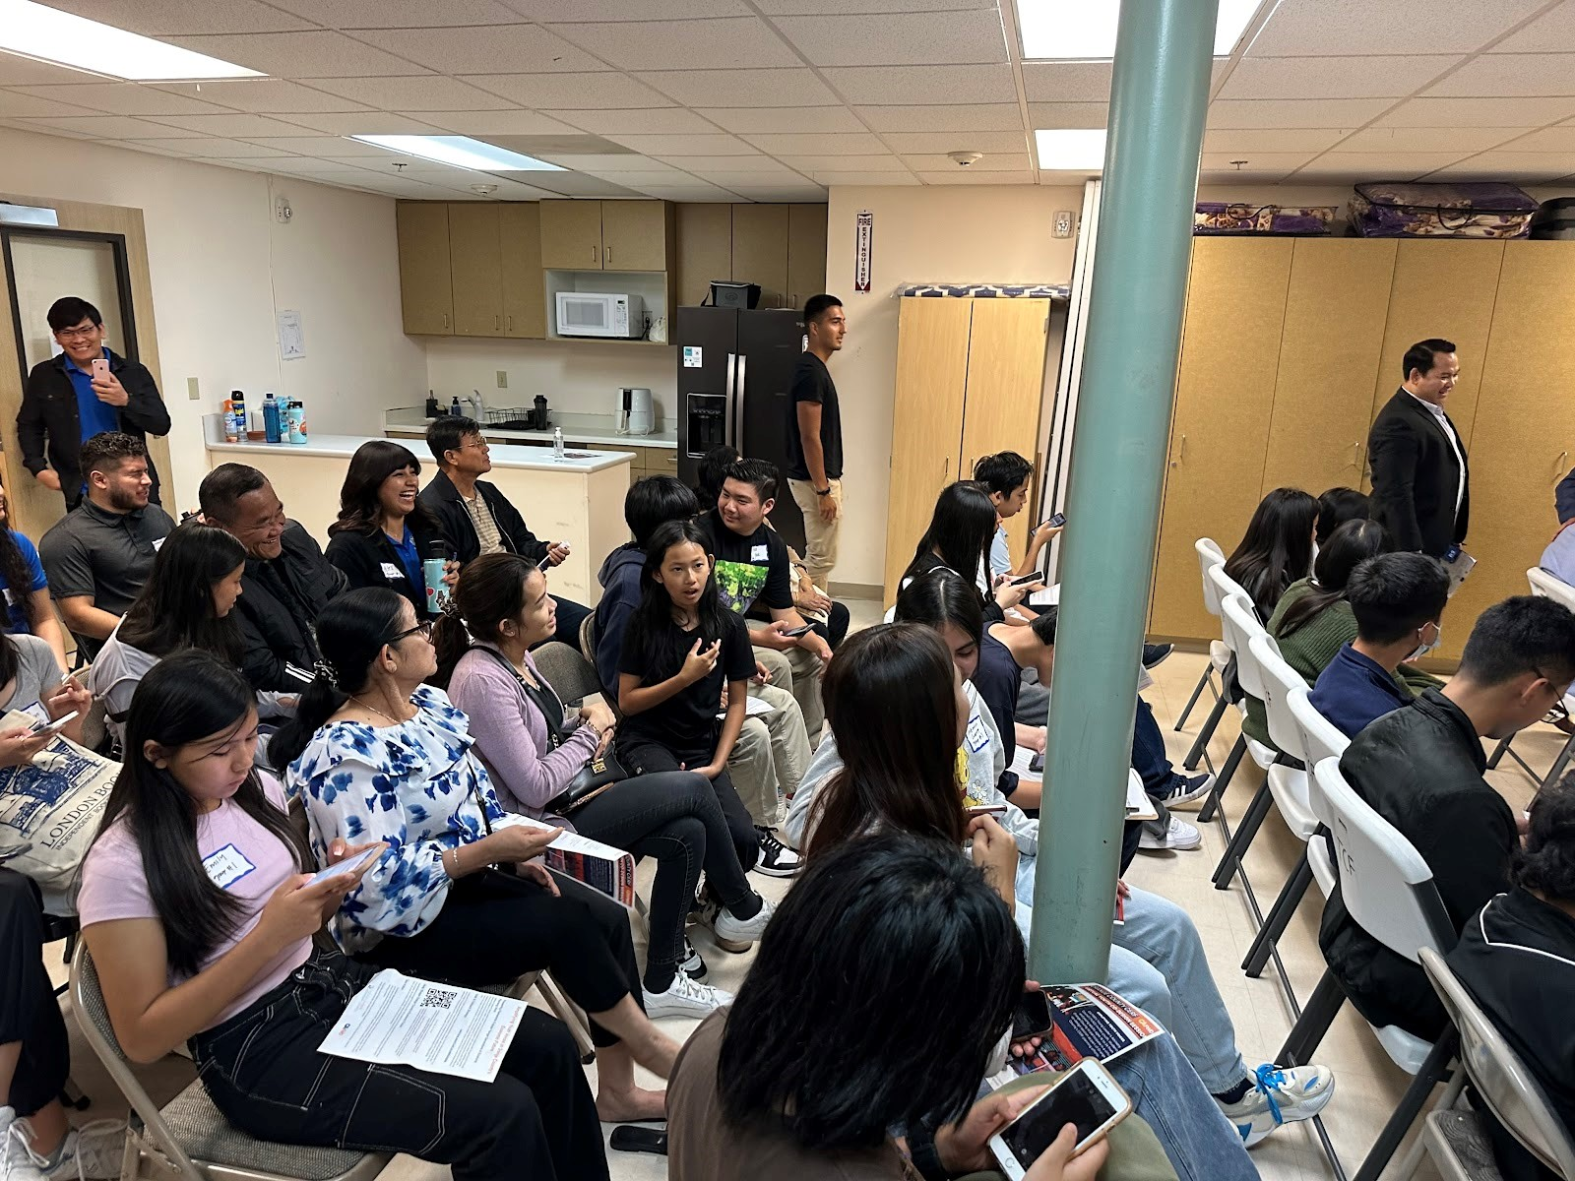
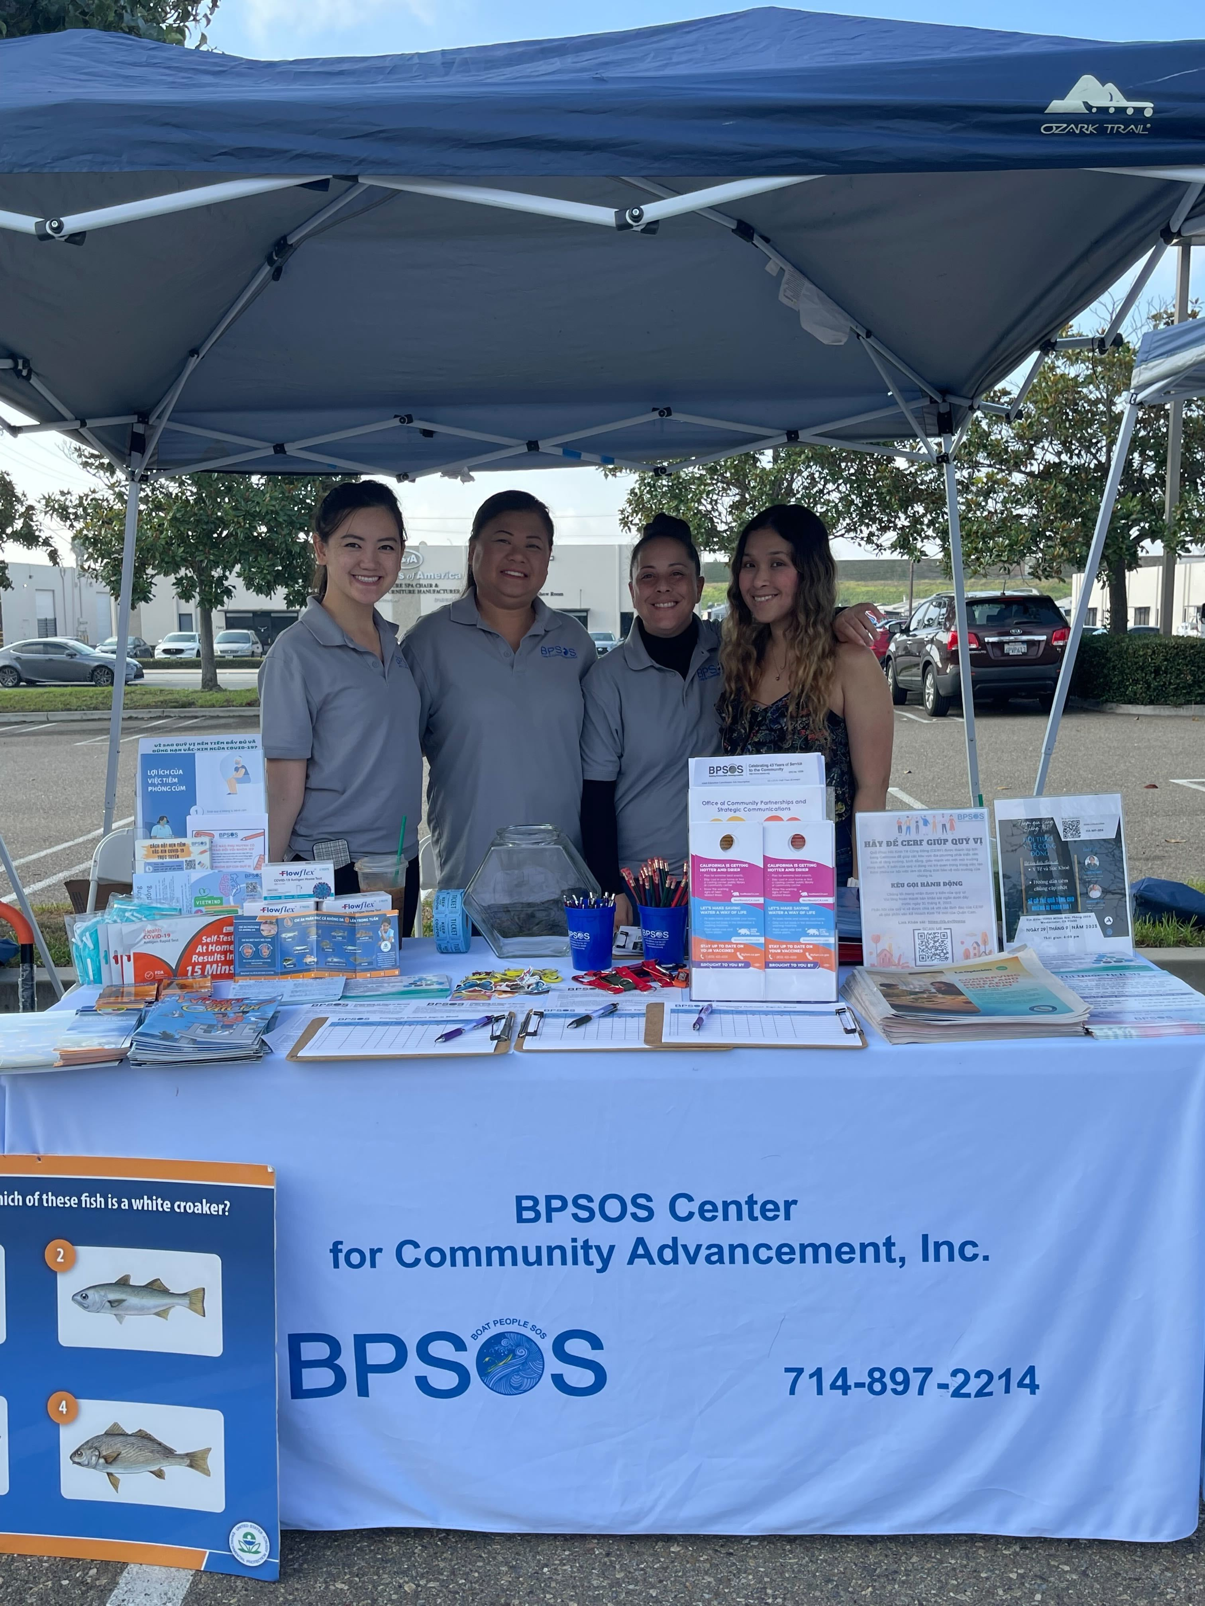
Outreach in action
California Forward
Abrazar
BPSOS

Slide 7
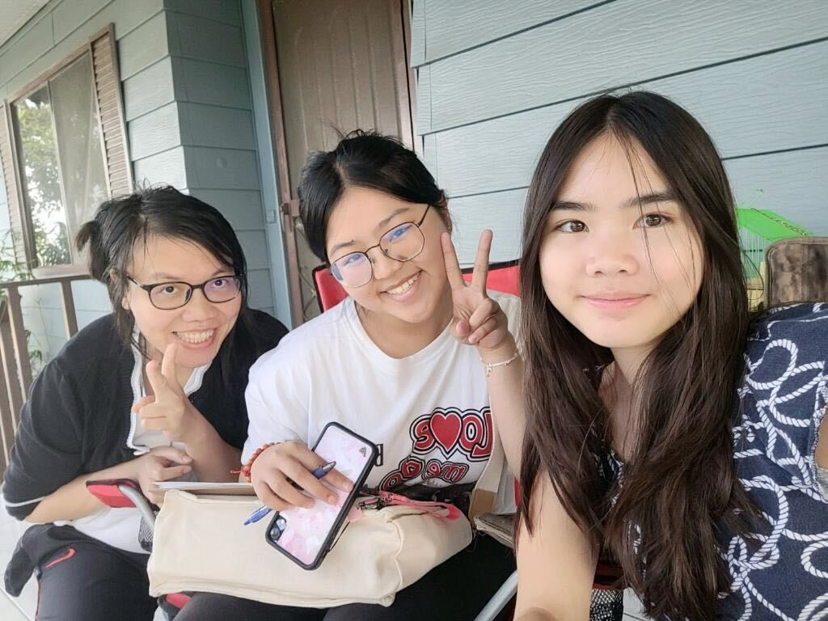
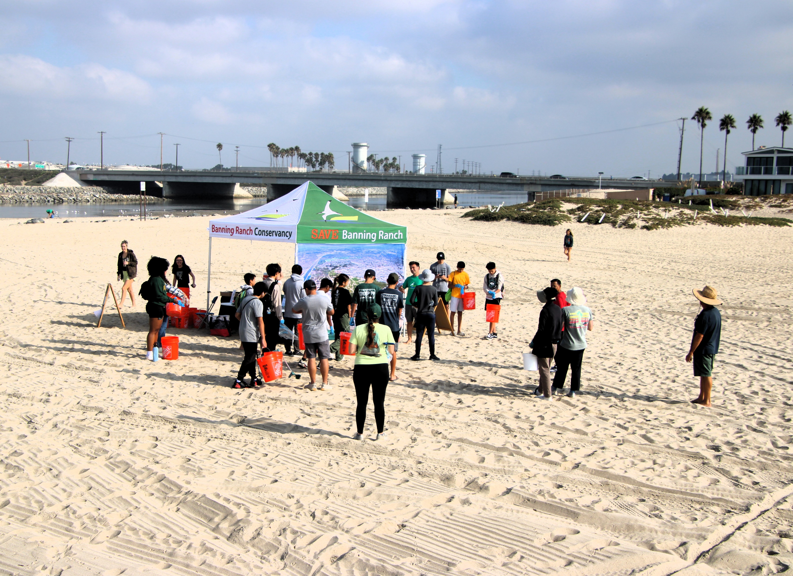
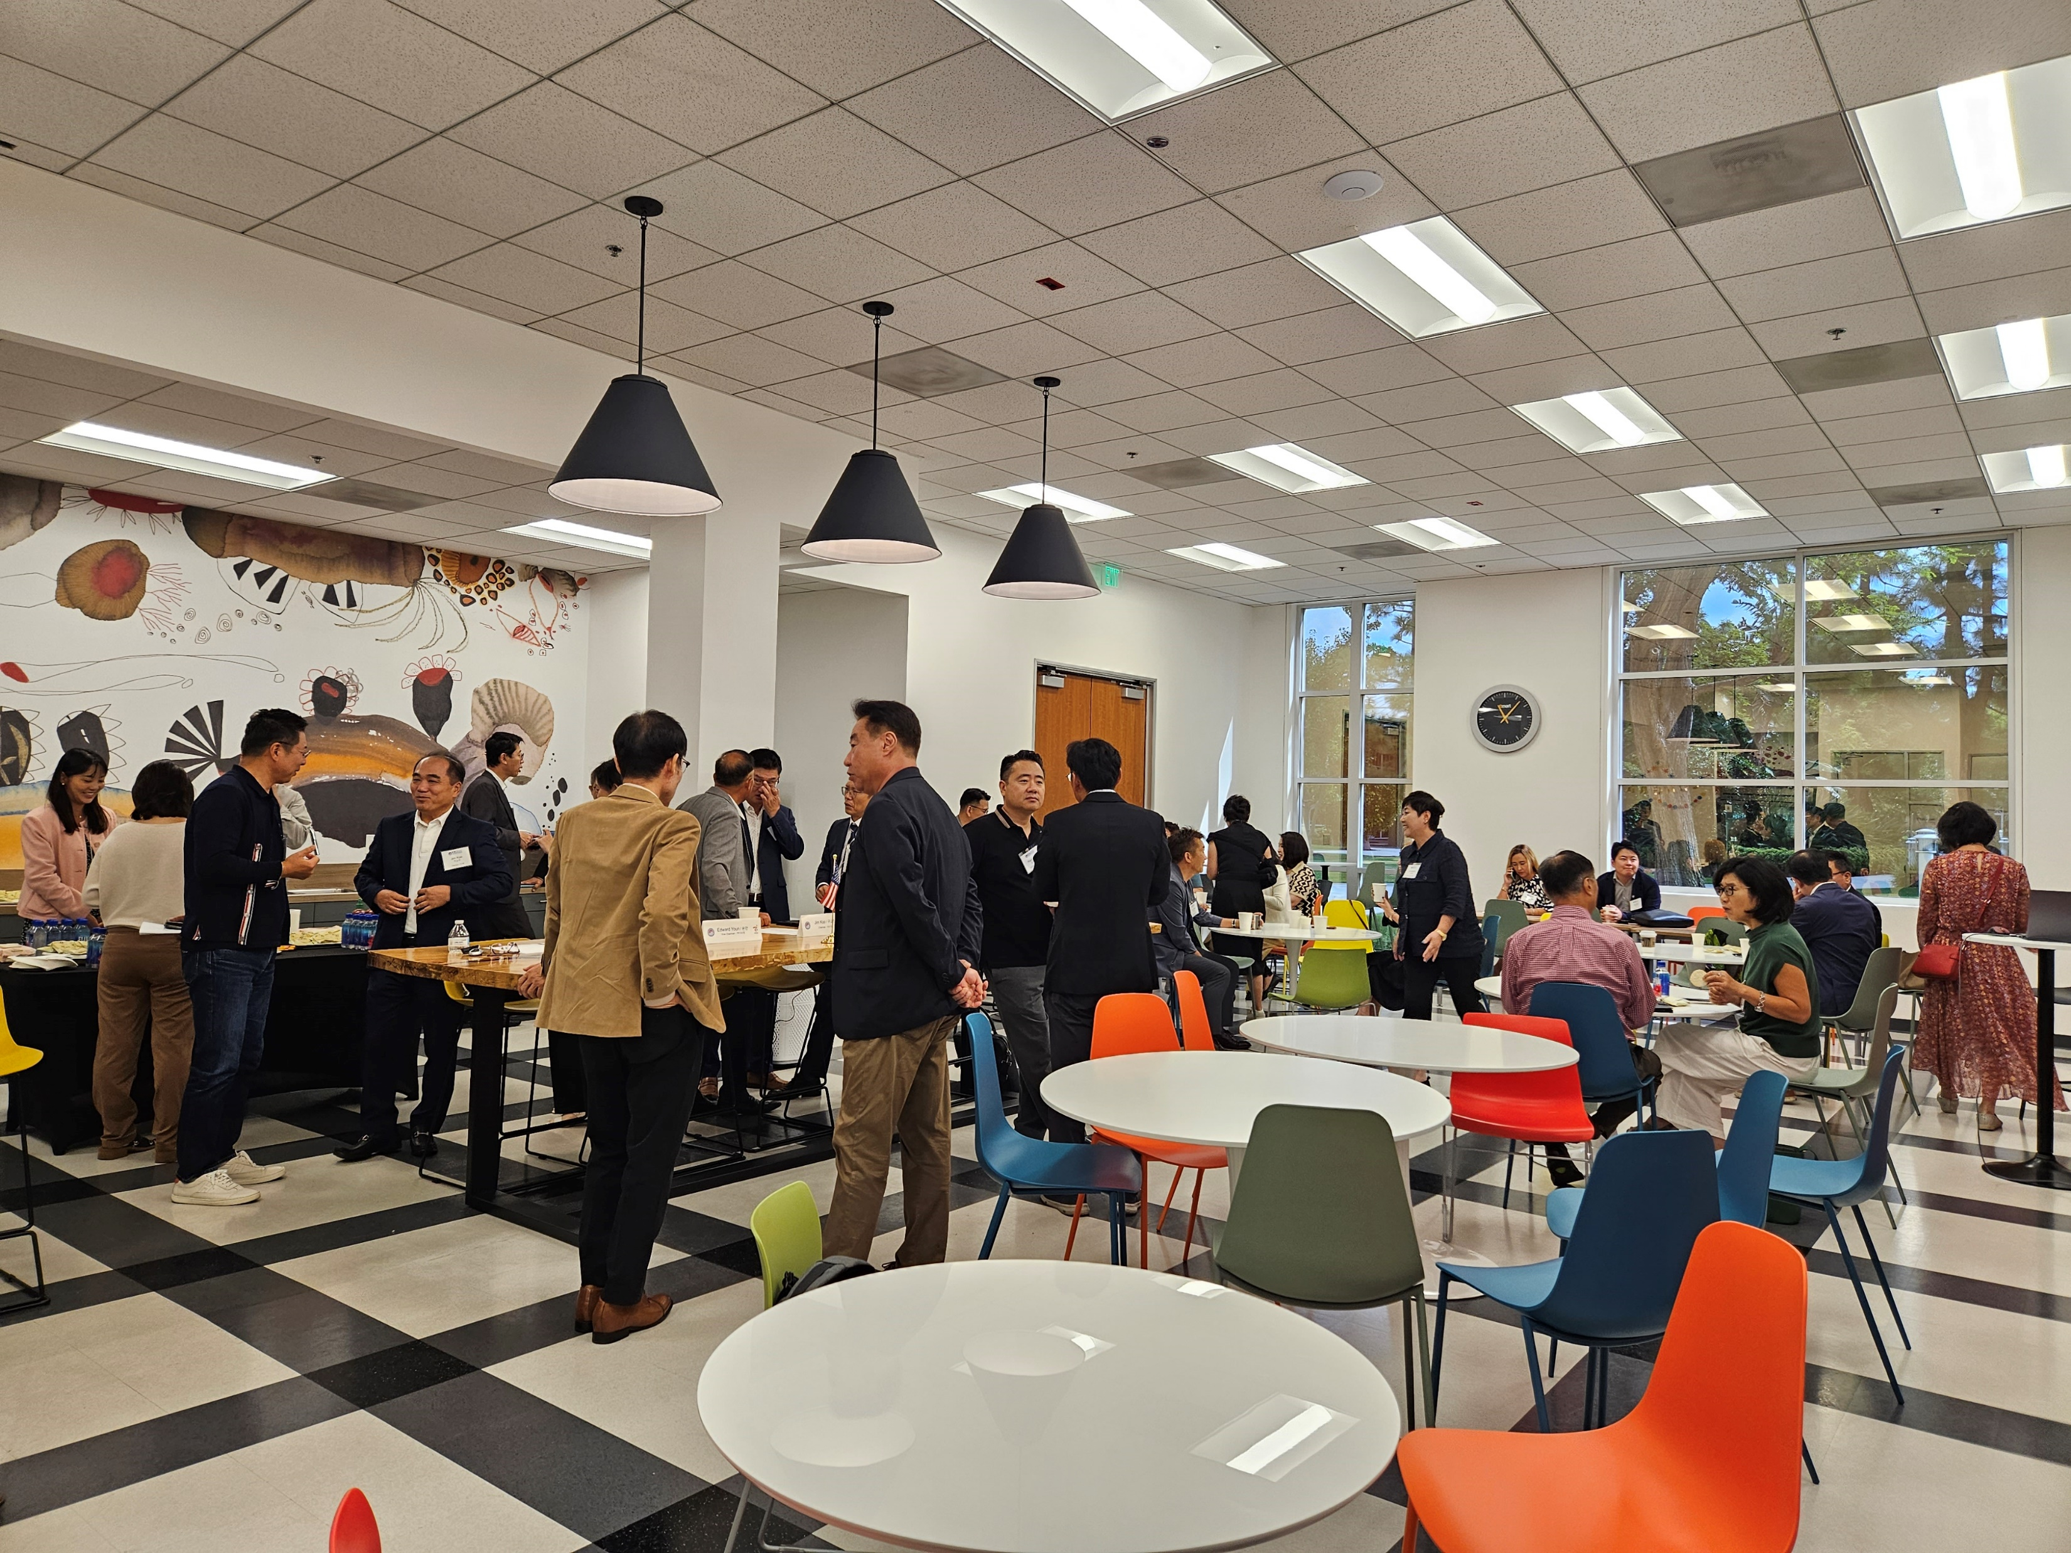
More outreach in action
VietRISE
Banning Ranch Conservancy
Korean American Chamber of Commerce of Orange County

